Slide 1


DEPARTMENT OF INFORMATION TECHNOLOGY
V R SIDDHARTHA ENGINEERING COLLEGE
Interpreting Doctors Handwritten Prescription Using
Deep Learning Techniques
Domain : Health Care
B.Tech in INFORMATION TECHNOLOGY
EPICS Project Review Presentation
Presented by :
RIZWANULLAH MD ( 208W1A1299 )
AJAY KUMAR VARMA N ( 208W1A12A1 )
Under the guidance of
DR M SUNEETHA
( Professor & Head )

Slide 2
01
Agenda :
Problem Statement & Objective’s
02
Literature Review
03
Justification for Societal impact
04
Datasets and Software Requirements
05
Architecture Diagram
06
Algorithm
07
Implementation Steps
08
Demonstration of Results and Analysis

Slide 3
Problem Statement
Interpreting Doctor’s handwritten prescription using Deep Learning techniques.

Slide 4
Abstract
A Doctor’s Handwriting Recognition model can predict the text present in the doctor’s prescription, by feeding image of that medicine name as an input to the model and model will predict and return the digital text.
Bi-Directional LSTM vs Bi-Directional GRU, which among this two Algorithms gives better performance and suitable for this Application ie to demonstrate which model is best for this Application.
Keywords: Bi-LSTM Layers ,Bi-GRU Layers, Convolution Layers, Adam optimizer, Batch Normalization.

Slide 5
OBJECTIVE’S OF PROJECT
Solution to digitize the handwritten text on prescription with better performing deep learning models.
The goal of this project is to build a model which accurately recognizes the Doctor’s Handwriting.

Slide 6
JUSTIFICATION FOR SOCIETIAL IMPACT
It is commonly seen that it is tough to read the handwritten text from medical prescriptions.
This can make it difficult for pharmacists to read the prescription, which can have negative or even fatal consequences if read incorrectly.
Pharmaceutical people can understand handwriting of doctor so that we can avoid any negative consequences like deaths due to misunderstanding of medicine name.

Slide 7
LITERATURE REVIEW
Sno | Paper | Methodology | Year | Algorithm | Drawbacks
1 | Convolutional neural network based intelligent handwritten document recognition | Has developed a model based on Convolutional neural networks to recognize handwritten text in documents. | 2022 | Convolutional neural networks. | Instead of finding Accuracy for single letter, it can found be for each complete word and this improves model’s recognizing ability.
2 | An efficient hybrid model for arabic text recognition | Have developed model based on CNN-LSTM model for hand writing recognition, They used CTC loss functions for Normalization. They passed input to 7 Convolution Layers. | 2022 | CNN-Bi-LSTM Model. | They got 80% Accuracy with CNN+Bi-LSTM+CTC architecture.

Slide 8
Sno | Paper | Methodology | Year | Algorithm | Drawbacks
3 | A convolutional recursive deep architecture for unconstrained Urdu handwriting recognition | Have developed model to recognize urdu handwriting with CNN-RNN Algorithm. | 2022 | CNN+RNN | They got 5.28% CER Loss which is somewhat high than usual cases. Some advanced bi directional methodology must be chosen.
4 | Handwritten Text Recognition using Deep Learning | Have developed a model for handwriting recognition with two dimensional LSTM Algorithm. | 2020 | Two dimensional Long short term memory | They got CER (character error rate) of 6% and word error rate of 20%
5 | Medical Handwritten Prescription Recognition Using CRNN | Have Developed model based on Convolutional Recurrent Neural Networks(CRNN).They Trained model with some short texts which contain Alpha- numeric Characters, Spaces etc. | 2019 | Convolutional Recurrent Neural Networks (CRNN). | As this is uni directional RNN’s the Recognition rate will be low and accuracy they obtained is 75%

Slide 9
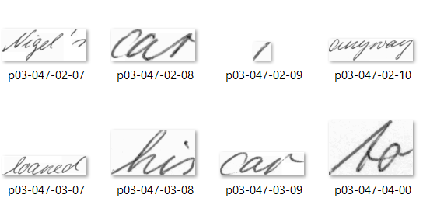
DATASET
Doctors hand writing dataset : https://github.com/rizwanrockzz/epics/tree/main/dataset
IAM hand writing dataset : https://git.io/J0fjL

Slide 10
SOFTWARE REQUIREMENTS
User Requirements:
Dataset acquired from ieee.org
Input is an image with doctor prescription.
Output is digital text displayed on Screen.
Functional Requirements:
Python Programming Language.
Bi directional LSTM model.
Tensorflow,keras Py Libraries.
System Requirements:
Windows Operating System.
Configuration: RAM 8GB with GPU.
Software : Google Colab.
Non-Functional Requirements:
Accuracy.
Reliability.
Loss

Slide 11
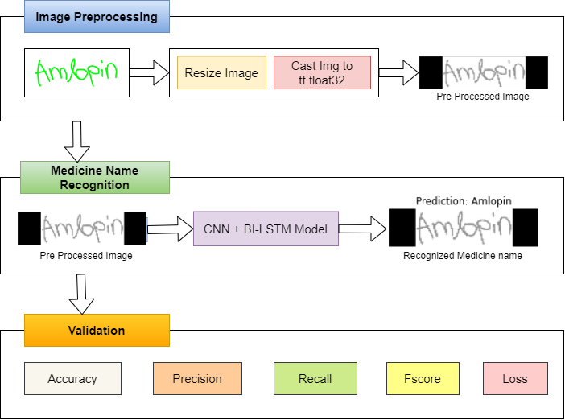
ARCHITECTURE
diagram

Slide 12
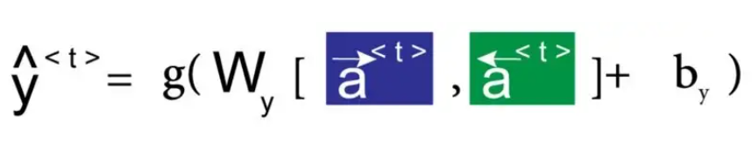
ALGORITHM For Bi-Directional LSTM
Mathematical Equation For Bi-Directional LSTM Model is Below:
Here we apply forward propagation 2 times , one for the forward cells and one for the backward cells
Both activations(forward , backward) would be considered to calculate the output y^ at time t
$h_{t}=G_{forward}\left(x_{t},\vec{h_{t−1}}\right)⊕ G_{backward}\left(x_{t},\overset{⃖}{h_{t+1}}\right)$ -(2) Bi-Directional GRU

Slide 13
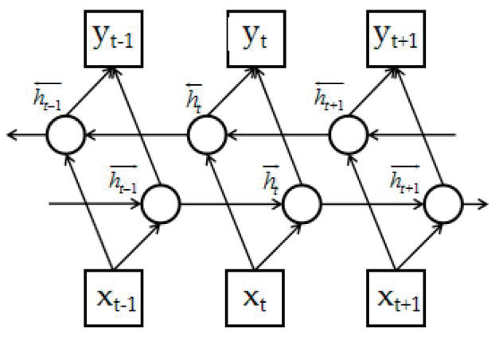
Structure of Bi-Directional LSTM Networks
How cells are connected forward and backward in Bi-Directional LSTM Model

Slide 14
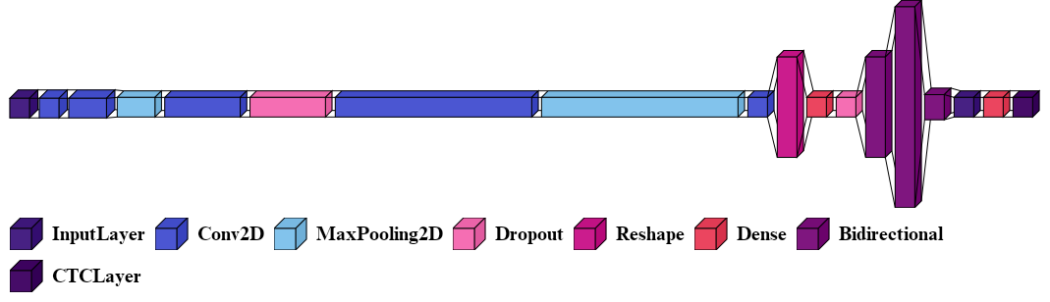
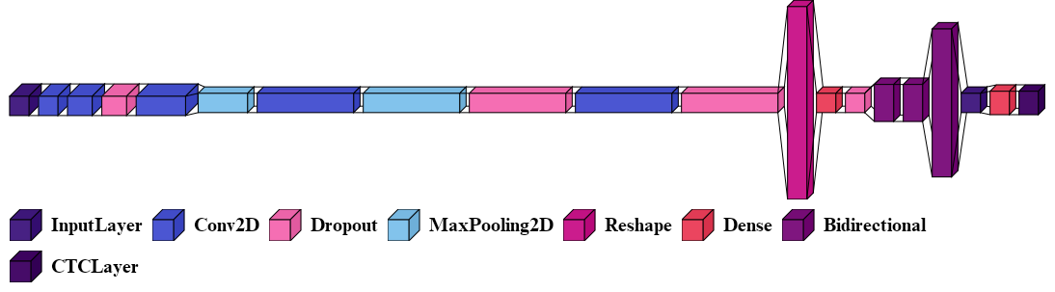
Fig : Architecture of Network Topology with Bi-LSTM
Fig : Architecture of Network Topology with Bi-GRU

Slide 15
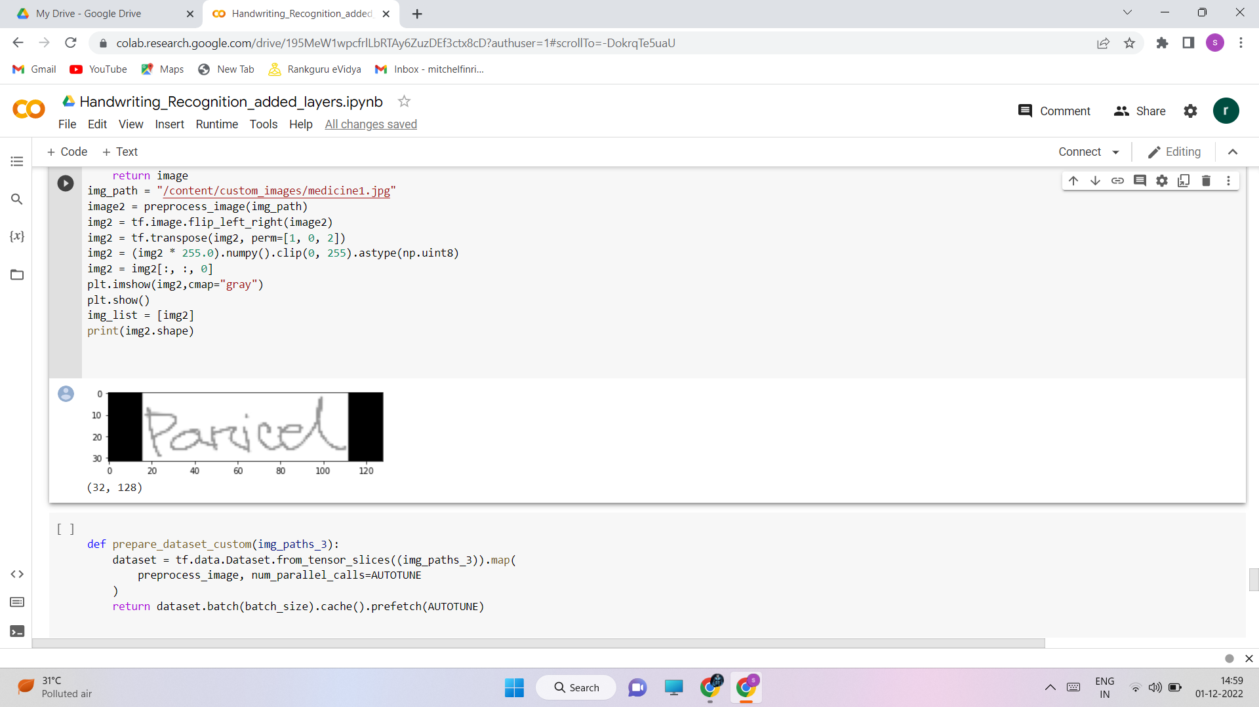
IMPLEMENTATION STEPS
The above image shows how Pre-Processing is done.
The network has a sophisticated design that includes seven convolutional layers, optional batch Normalization layers, Max Pooling layers, Relu activation functions, a Bi-directional LSTM layer, and a CTC layer.The procedure increases the number of channels in the first convolution layer from 1 to 64. which, after several layers, is raised to 128.
The Bi LSTM layer aids in decoding of the convolution layer-generated feature mapping. Next create a layer for label input for the appropriate images, followed by a thick layer. To find the CTC loss, the last layer would be the CTC layer. The next step is to determine the callback distance.

Slide 16
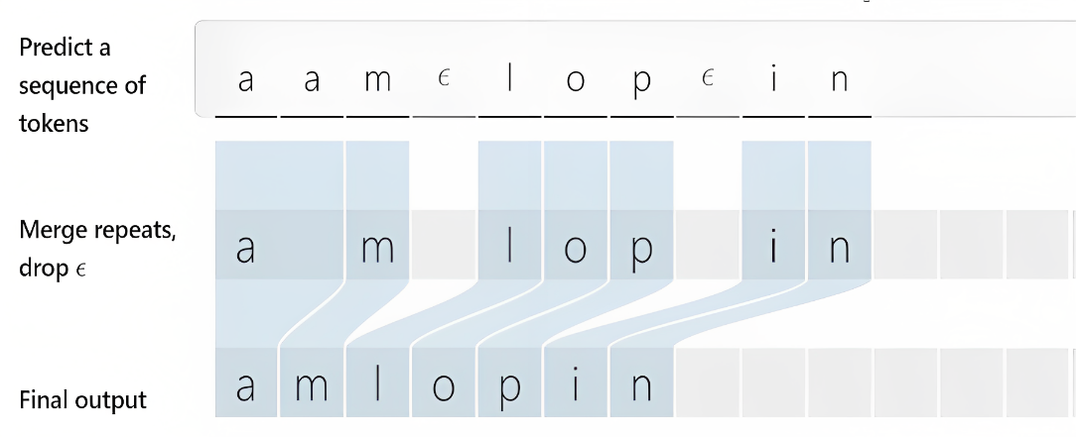
The Working Of CTC Layer
It doesn’t use any traditional aligning methods, instead it will eliminate the process of Alignment. Bi-LSTM or Bi-GRU may output 'Amlopin' as a series of characters. The custom CTC Layer filters characters in each word.

Slide 17
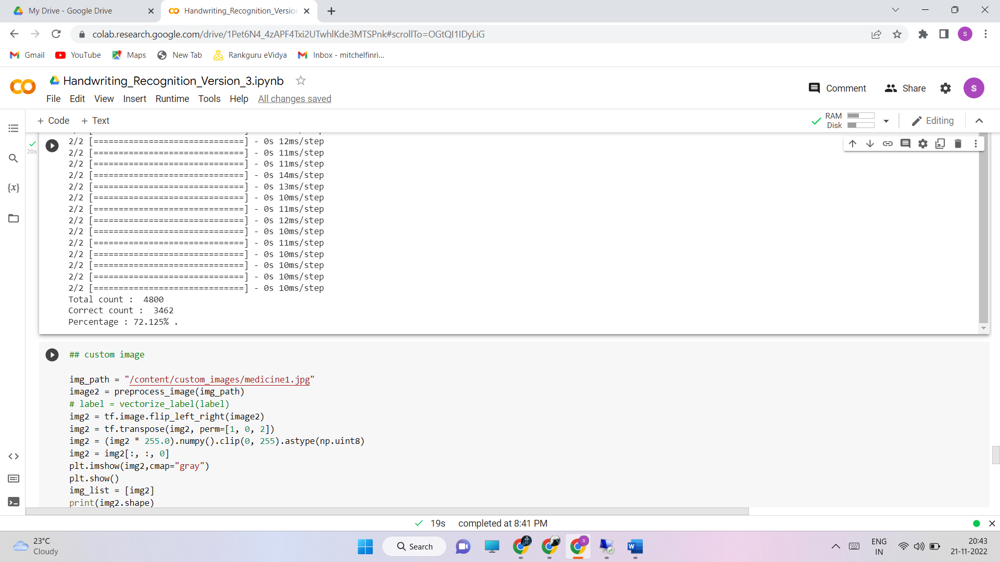
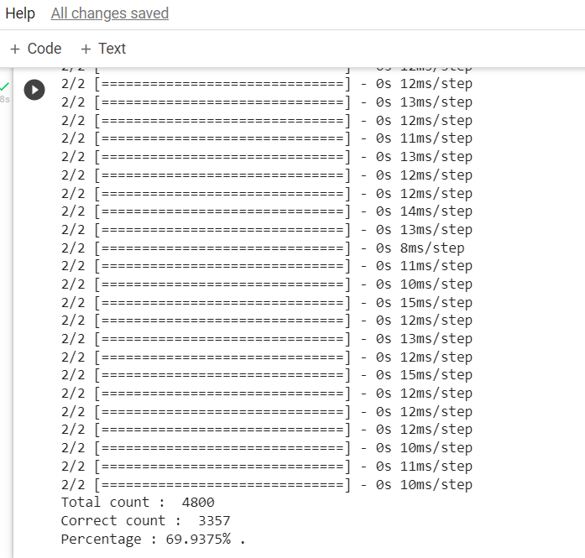
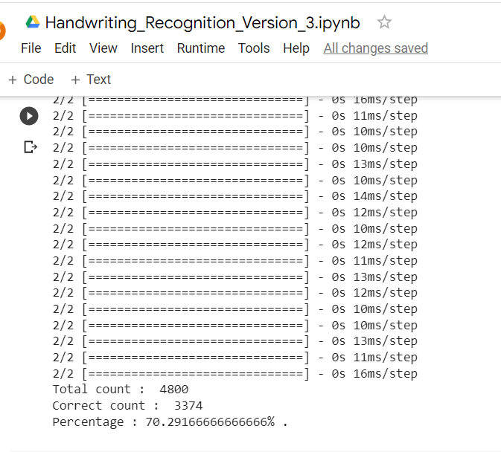
Demonstration of result & analysis
90:5:5 with Epoch 50
80:10:10 with Epoch 50
70:15:15 with Epoch 50

Slide 18
Analysis
Ratios (train : validation : testing) | Highest Accuracy epoch
70:15:15 | 30
80:10:10 | 30
90:5:5 | 30
70:15:15
80:10:10
90:5:5
Epoch | LSTM Accuracy | GRU Accuracy
20 | 69 | 66
25 | 70 | 68
30 | 72 | 69
Epoch | LSTM Accuracy | GRU Accuracy
20 | 71 | 68
25 | 74 | 70
30 | 77 | 73
Epoch | LSTM Accuracy | GRU Accuracy
20 | 75 | 71
25 | 77 | 75
30 | 81 | 77
The model got 81% accuracy WITH LSTM when data splitting ratio is 90:5:5 with epoch 30

Slide 19
VALIDATION Analysis
Accuracy : 81%
Precision : 0.96
Recall : 0.83
FScore : 0.89

Slide 20
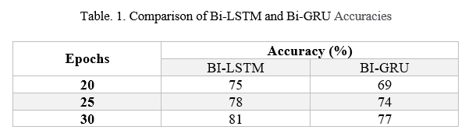
Bi-DIRECTIONAL LSTM VS BI-DIRECTIONAL GRU
The below are results obtained for both Bi-LSTM and Bi-GRU
For Bi-LSTM we changed network topology

Slide 21
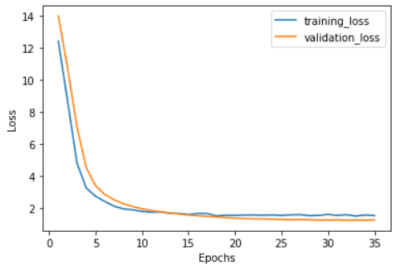
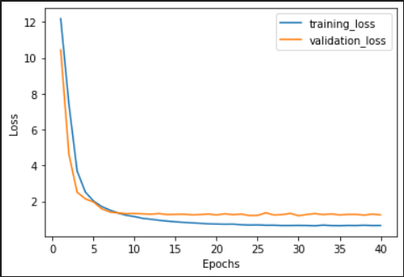
Losses vs epochs graph for both models
Loss vs Epochs for Bi-LSTM
Loss vs Epochs for Bi-GRU

Slide 22
CONCLUSIONS and future scope
Finally this model helps pharmacists and normal people to recognize the medicine name accurately in the doctor’s handwritten prescription .
The accuracy for this model can be further improved by training with more handwritten prescriptions.
Bi-Directional LSTM is giving better performance than Bi-Directional GRU. So,This is suitable algorithm to be used for this Application.
Further an API can be created for this model which can be useful mobile applications and web application to use this model for recognizing text from prescription.

Slide 23
REFERENCES
[1] S. Tabassum et al., "Recognition of Doctors’ Cursive Handwritten Medical Words by using Bidirectional LSTM and SRP Data Augmentation," 2021 IEEE Technology & Engineering Management Conference - Europe (TEMSCON-EUR), 2021, pp. 1-6
[2] T. Jain, R. Sharma and R. Malhotra, "Handwriting Recognition for Medical Prescriptions using a CNN-Bi-LSTM Model," 2021 6th International Conference for Convergence in Technology (I2CT), 2021, pp. 1-4, doi: 10.1109/I2CT51068.2021.9418153
[3] L. J. Fajardo et al., "Doctor’s Cursive Handwriting Recognition System Using Deep Learning," 2019 IEEE 11th International Conference on Humanoid, Nanotechnology, Information Technology, Communication and Control, Environment, and Management ( HNICEM ), 2019, pp. 1-6.
[4] España-Boquera, S., Castro-Bleda, M.J.”A Spanish dataset for reproducible benchmarked offline handwriting recognition”. Lang Resources & Evaluation 56, 1009–1022 (2022).

Slide 24
Thank You

